Slide 1
Machine Learning 02- Mathematics for Machine Learning
Dr. Malak Abdullah
Computer Science Department
Jordan University of Science and Technology

Slide 2
Basic Statistics

Slide 3
Why study statistics?
Data are everywhere
Statistical techniques are used to make many decisions that affect our lives
No matter what your career, you will make professional decisions that involve data. An understanding of statistical methods will help you make these decisions efectively
https://www.youtube.com/watch?v=MXaJ7sa7q-8&list=PL0KQuRyPJoe6KjlUM6iNYgt8d0DwI-IGR

Slide 4
What Is Statistics?
Collecting Data
e.g., Survey
Presenting Data
e.g., Charts & Tables
Characterizing Data
e.g., Average
Data Analysis
Why?
© 1984-1994 T/Maker Co.
Decision- Making
© 1984-1994 T/Maker Co.
Notes:
:1, 1, 3

Slide 5
Two areas of statistics:
Statistics
The science of collecting, organizing, presenting, analyzing, and interpreting data to assist in making more effective decisions
Statistical analysis – used to manipulate summarize, and investigate data, so that useful decision-making information results.
Descriptive Statistics: collection, presentation, and description of sample data.
Inferential Statistics: making decisions and drawing conclusions about populations.

Slide 6
Descriptive Statistics
Inferential Statistics
Involves
Collecting Data
Presenting Data
Characterizing Data
Purpose
Describe Data
Involves
Estimation
Hypothesis Testing
Purpose
Make decisions about population characteristics
$
50
Population?
25
0
Q1
Q2
Q3
Q4
‾X = 30.5 S² = 113

Slide 7
Types of Statistics/Analyses
Descriptive Statistics
Describing a phenomena
Frequencies
Basic measurements
Inferential Statistics
Hypothesis Testing
Correlation
Confidence Intervals
Significance Testing
Prediction
How many? How much?
BP, HR, BMI, IQ, etc.
Inferences about a phenomena
Proving or disproving theories
Associations between phenomena
If sample relates to the larger population
E.g., Diet and health

Slide 8
INFERENTIAL STATISTICS
Inferential statistics can be used to prove or disprove theories, determine associations between variables, and determine if findings are significant and whether or not we can generalize from our sample to the entire population
The types of inferential statistics :
Correlation
T-tests/ANOVA
Chi-square
Logistic Regression

Slide 9
Inferential Statistics
Estimation
e.g., Estimate the population mean weight using the sample mean weight
Hypothesis testing
e.g., Test the claim that the population mean weight is 70 kg
Inference is the process of drawing conclusions or making decisions about a population based on sample results

Slide 10
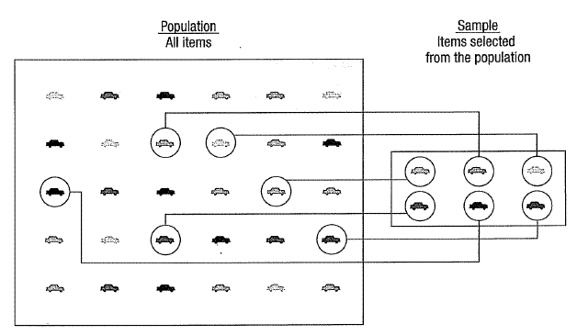
Introduction to Basic Terms
Population: A collection, or set, of individuals or objects or events whose properties are to be analyzed.
Sample: A subset of the population.
Statistical inference is the process of using data obtained from a sample to make estimates and test hypotheses about the characteristics of a population

Slide 11
Sampling methods
Sampling methods can be:
random (each member of the population has an equal chance of being selected)
nonrandom
The actual process of sampling causes sampling errors. For example, the sample may not be large enough or representative of the population.

Slide 12
Back to Basic Terms
Variable: A characteristic about each individual element of a population or sample.
Data (singular): The value of the variable associated with one element of a population or sample. This value may be a number, a word, or a symbol.
Data (plural): The set of values collected for the variable from each of the elements belonging to the sample.
Statistic: A numerical value summarizing the sample data.
Example: A college dean is interested in learning about the average age of faculty. Identify the basic terms in this situation.
The population is the age of all faculty members at the college.
A sample is any subset of that population. For example, we might select 10 faculty members and determine their age.
The variable is the “age” of each faculty member.
One data would be the age of a specific faculty member.
The data would be the set of values in the sample.
The statistic is the “average” age for all faculty in the sample.

Slide 13
Two kinds of variables:
Qualitative, or Attribute, or Categorical, Variable: A variable that categorizes or describes an element of a population (hair color, Department).
Qualitative data are generally described by words or letters. They are not as widely used as quantitative data because many numerical techniques do not apply to the qualitative data. For example, it does not make sense to find an average hair color or blood type.
Quantitative, or Numerical, Variable: A variable that quantifies an element of a population (height and weight, number of children in a family).
Quantitative data are always numbers and are the result of counting or measuring attributes of a population. Quantitative data can be separated into two subgroups:
discrete (if it is the result of counting (the number of students of a given ethnic group in a class, the number of books on a shelf, ...)
continuous (if it is the result of measuring (distance traveled, weight of luggage, …)

Slide 14
Qualitative and Quantitative Data
Example:
The grade point averages of five students are listed in the table. Which data are qualitative data and which are quantitative data?
Student | GPA
Sally | 3.22
Bob | 3.98
Cindy | 2.75
Mark | 2.24
Kathy | 3.84
Qualitative data
Quantitative data

Slide 15
Qualitative and quantitative variables may be further subdivided:
Nominal
Qualitative
Ordinal
Variable
Discrete
Quantitative
Continuous
Nominal Variable: A qualitative variable that categorizes (or describes, or names) an element of a population (hair color).
Ordinal Variable: A qualitative variable that incorporates an ordered position, or ranking (level of happiness).
Discrete Variable: A quantitative variable that can assume a countable number of values (number of students in each class).
Continuous Variable: A quantitative variable that can assume an uncountable number of values. Intuitively, a continuous variable can assume any value along a line interval, including every possible value between any two values (salary of an employee).

Slide 16
Descriptive Statistics
Types of descriptive statistics:
Organize Data
Tables
Graphs
Summarize Data
Central Tendency
Variation

Slide 17
Descriptive Statistics
Summarizing Data:
Central Tendency (or Groups’ “Middle Values”)
Mean
Median
Mode
Variation (or Summary of Differences Within Groups)
Range
Interquartile Range
Variance
Standard Deviation

Slide 18
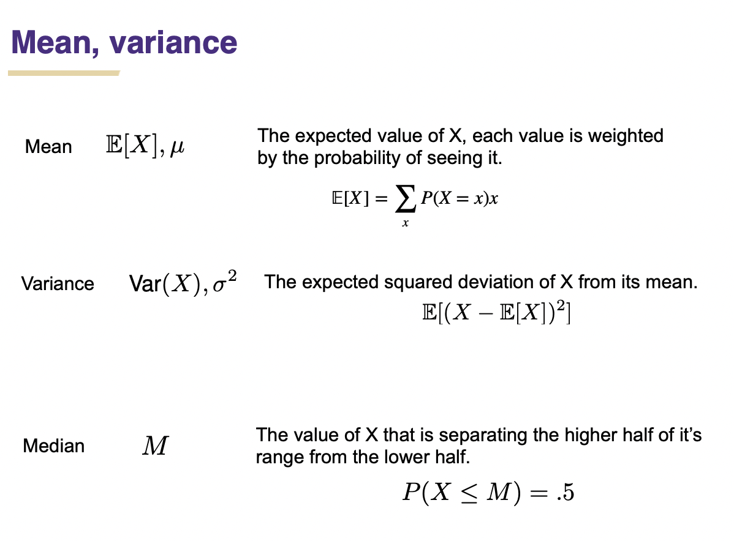

Slide 19
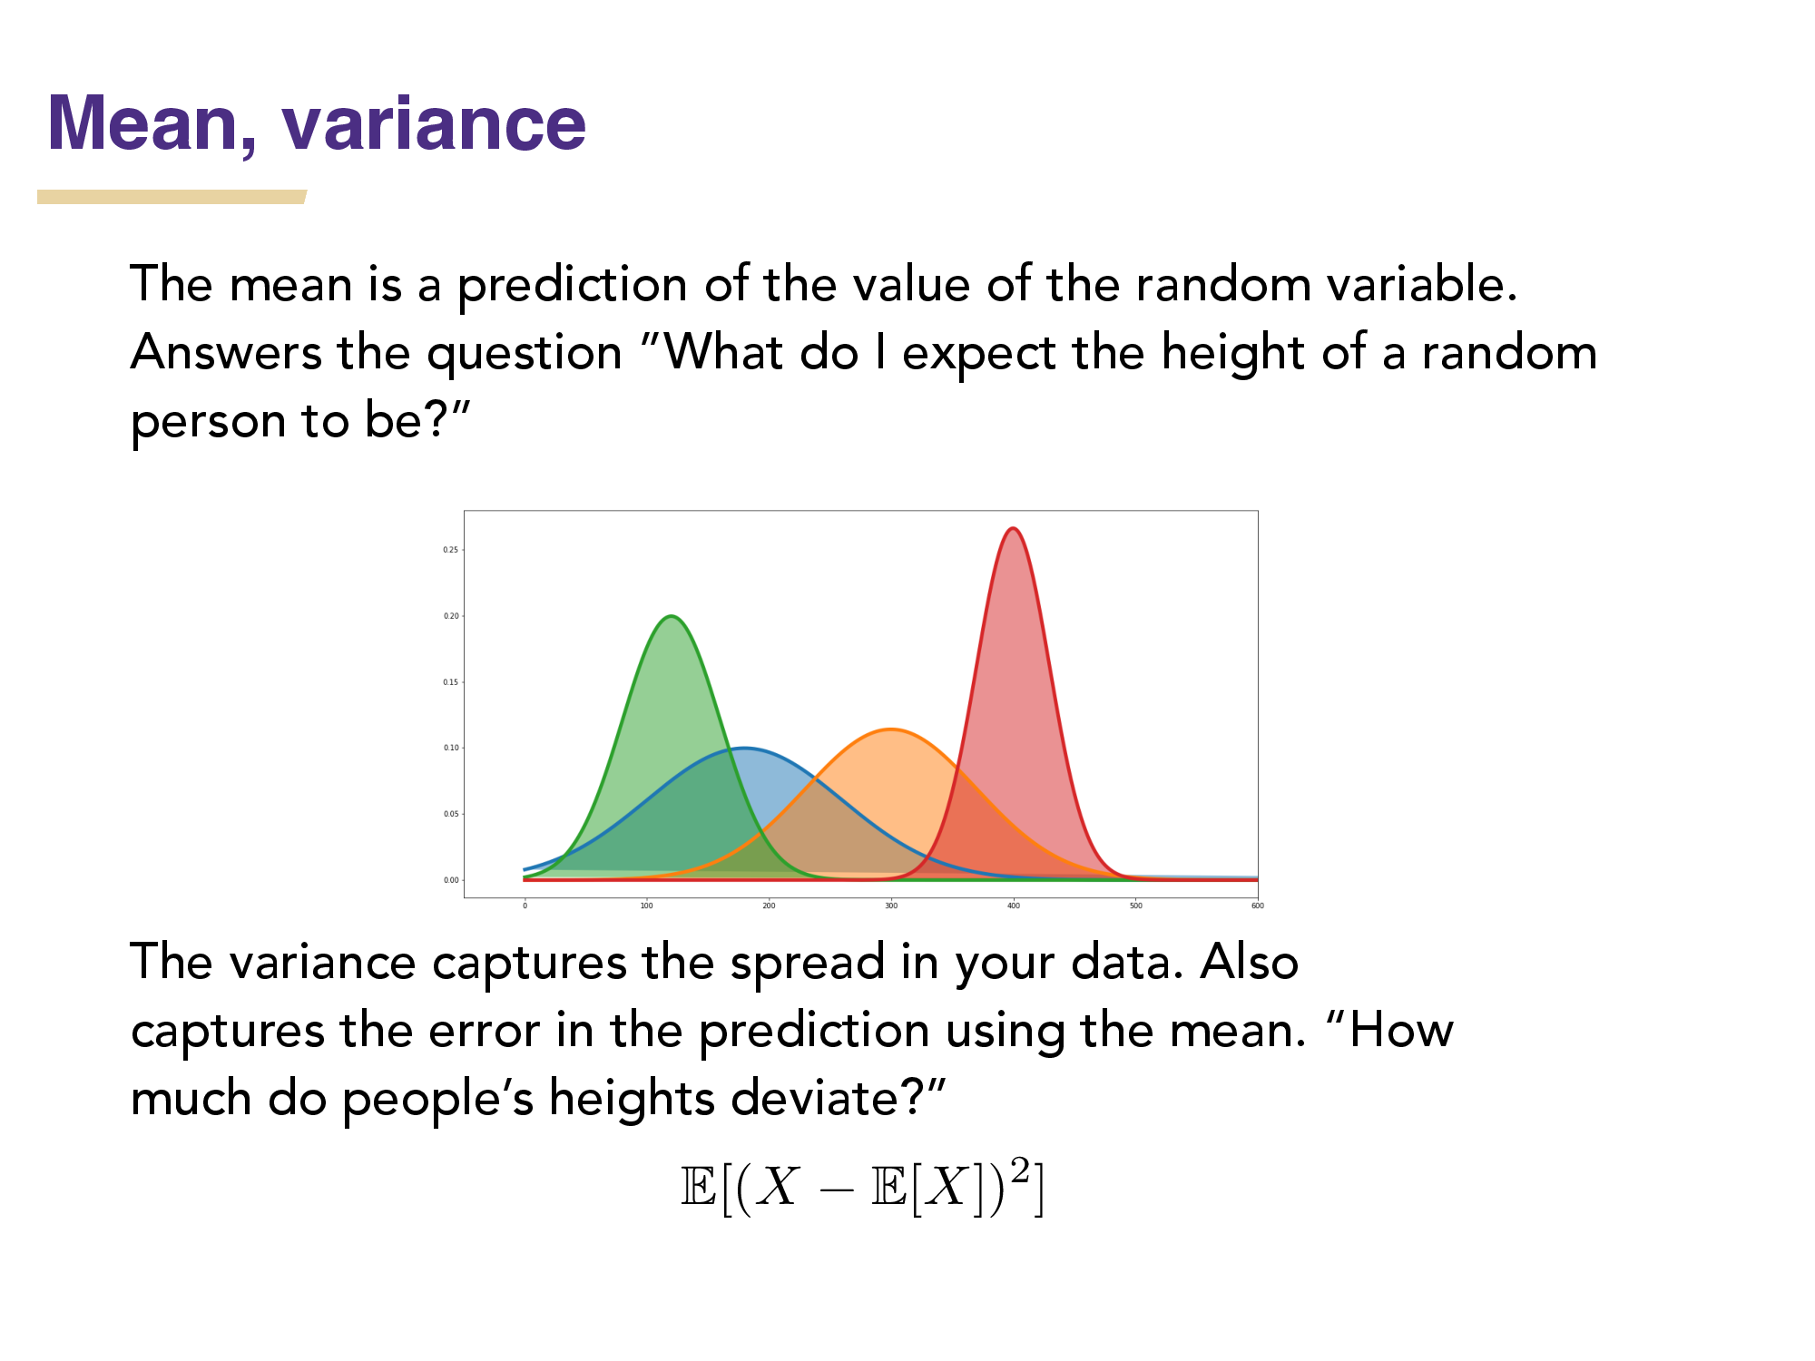

Slide 20
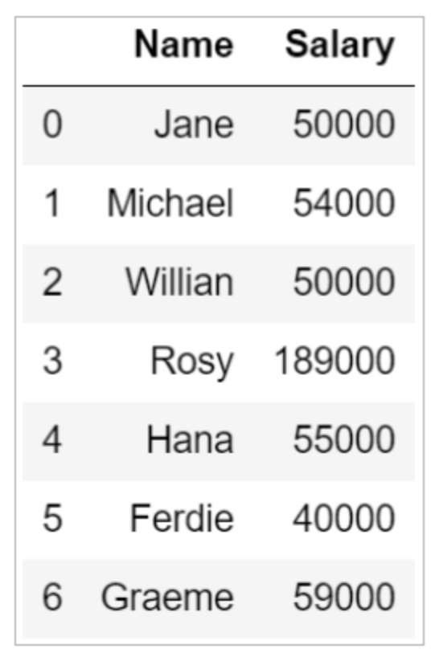
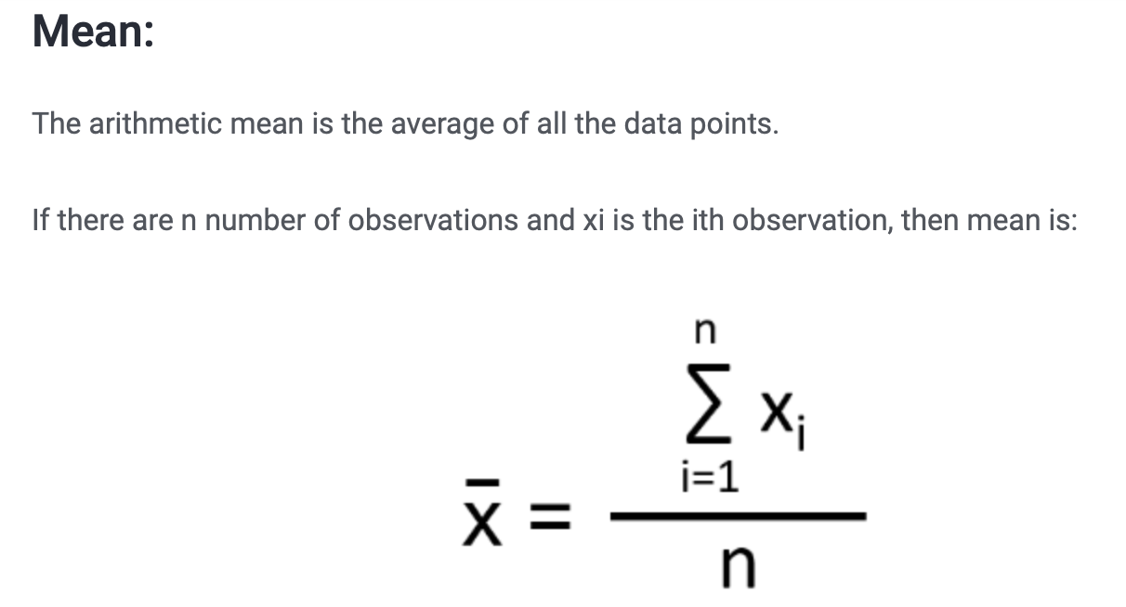
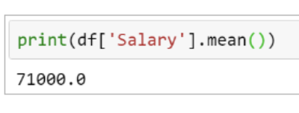
Mean
Most commonly called the “average.”

Slide 21
Mean
Means can be badly affected by outliers (data points with extreme values unlike the rest)
Outliers can make the mean a bad measure of central tendency or common experience
Income in the U.S.
All of Us
Bill Gates
Mean
Outlier

Slide 22
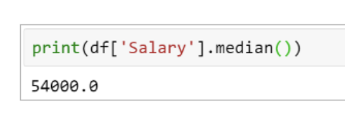
Median
The middle value when a variable’s values are ranked in order; the point that divides a distribution into two equal halves.
When data are listed in order, the median is the point at which 50% of the cases are above and 50% below it.
The 50th percentile.

Slide 23
Median
The median is unaffected by outliers, making it a better measure of central tendency, better describing the “typical person” than the mean when data are skewed.
All of Us
Bill Gates
outlier

Slide 24
Median
If the recorded values for a variable form a symmetric distribution, the median and mean are identical.
In skewed data, the mean lies further toward the skew than the median.
Symmetric
Skewed
Mean
Mean
Median
Median

Slide 25
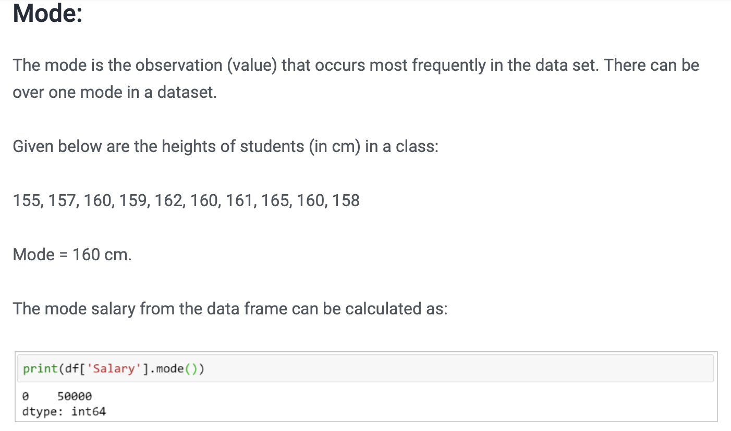
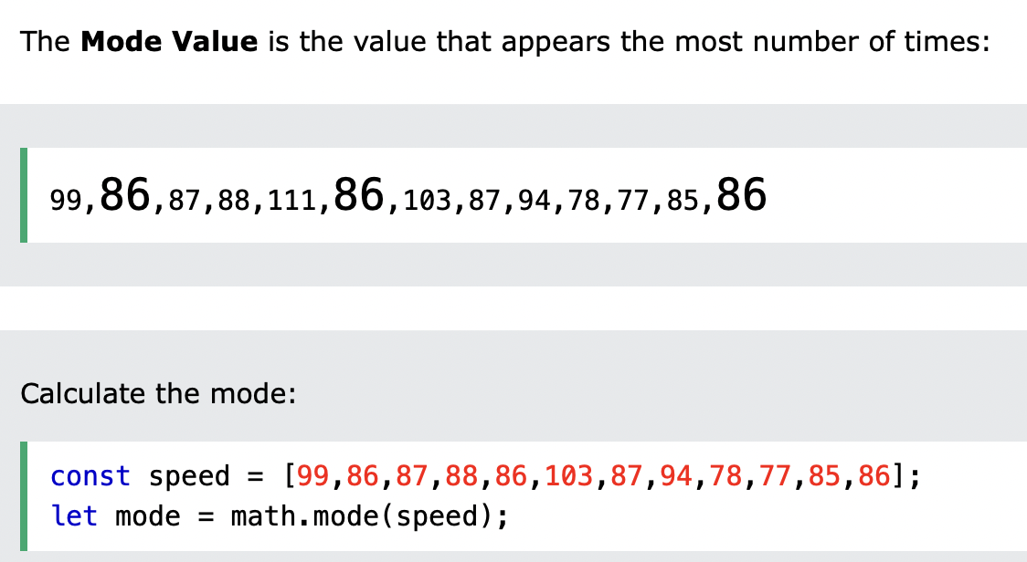
Mode
BTW, It is possible to have more than one mode!

Slide 26
Mode
It may give you the most likely experience rather than the “typical” or “central” experience.
In symmetric distributions, the mean, median, and mode are the same.
In skewed data, the mean and median lie further toward the skew than the mode.
Symmetric
Skewed
Mean
Median
Mode
Mode
Median
Mean

Slide 27
Descriptive Statistics
Summarizing Data:
Central Tendency (or Groups’ “Middle Values”)
Mean
Median
Mode
https://repl.it/@DrMalak/CentralTendencies
Variation (or Summary of Differences Within Groups)
Range
Interquartile Range
Variance
Standard Deviation

Slide 28
Variance
A measure of the spread of the recorded values on a variable. A measure of dispersion.
The larger the variance, the further the individual cases are from the mean.
The smaller the variance, the closer the individual scores are to the mean.
Mean
Mean

Slide 29
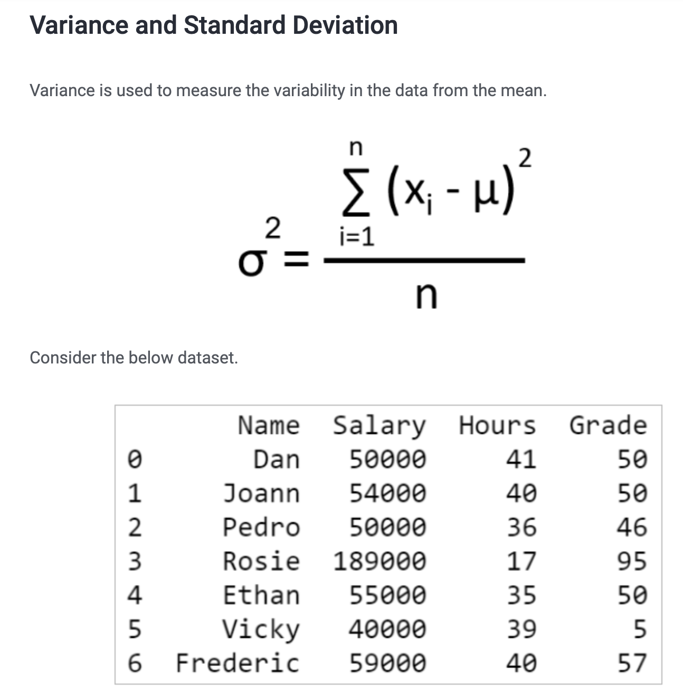
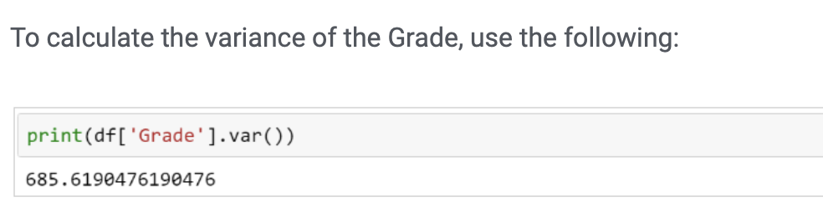
Variance

Slide 30
Variance

Slide 31
Variance
Variance is a number that at first seems complex to calculate.
Calculating variance starts with a “deviation.”
A deviation is the distance away from the mean of a case’s score.
Yi – Y-bar
If the average person’s car costs $20,000, my deviation from the mean is - $14,000!
6K - 20K = -14K

Slide 32
Variance
The deviation of 102 from 110.54 is? Deviation of 115?
102 - 110.54 = -8.54 115 - 110.54 = 4.46
Class A--IQs of 13 Students
102 115
128 109
131 89
98 106
140 119
93 97
110
Y-bar_{A} = 110.54

Slide 33
Variance
We want to add these to get total deviations, but if we were to do that, we would get zero every time. Why?
We need a way to eliminate negative signs.
Squaring the deviations will eliminate negative signs...
A Deviation Squared: (Yi – Y-bar)²
Back to the IQ example,
A deviation squared for 102 is: of 115:
(102 - 110.54)² = (-8.54)² ⁼ 72.93 (115 - 110.54)² = (4.46)² = 19.89

Slide 34
Variance
If you were to add all the squared deviations together, you’d get what we call the
“Sum of Squares.”
Sum of Squares (SS) = Σ (Yi – Y-bar)²
SS = (Y1 – Y-bar)² + (Y2 – Y-bar)² + . . . + (Yn – Y-bar)²

Slide 35
Variance
Class A, sum of squares:
(102 – 110.54)² + (115 – 110.54)² +
(126 – 110.54)² + (109 – 110.54)² +
(131 – 110.54)² + (89 – 110.54)² +
(98 – 110.54)² + (106 – 110.54)² +
(140 – 110.54)² + (119 – 110.54)² +
(93 – 110.54)² + (97 – 110.54)² +
(110 – 110.54) = SS = 2825.39
Class A--IQs of 13 Students
102 115
128 109
131 89
98 106
140 119
93 97
110
Y-bar = 110.54

Slide 36
Variance
The last step…
The approximate average sum of squares is the variance.
SS/N = Variance for a population.
SS/n-1 = Variance for a sample.
Variance = Σ(Yi – Y-bar)² / n – 1
The reason dividing by n-1 corrects the bias is because we are using the sample mean, instead of the population mean, to calculate the variance. Since the sample mean is based on the data, it will get drawn toward the center of mass for the data.

Slide 37
Variance
For Class A, Variance = 2825.39 / n - 1
= 2825.39 / 12 = 235.45
How helpful is that???

Slide 38
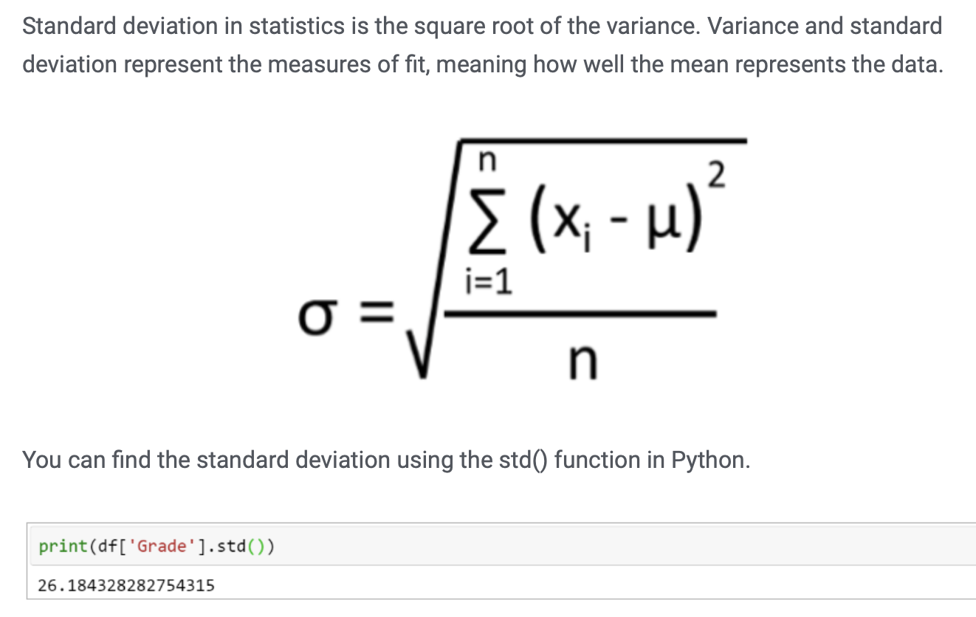
Standard Deviation
To convert variance into something of meaning, let’s create standard deviation.
The square root of the variance reveals the average deviation of the observations from the mean.
s.d. = Σ(Yi – Y-bar)²
n - 1

Slide 39
Standard Deviation
For Class A, the standard deviation is:
235.45 = 15.34
The average of persons’ deviation from the mean IQ of 110.54 is 15.34 IQ points.
Review:
1. Deviation
2. Deviation squared
3. Sum of squares
4. Variance
5. Standard deviation

Slide 40
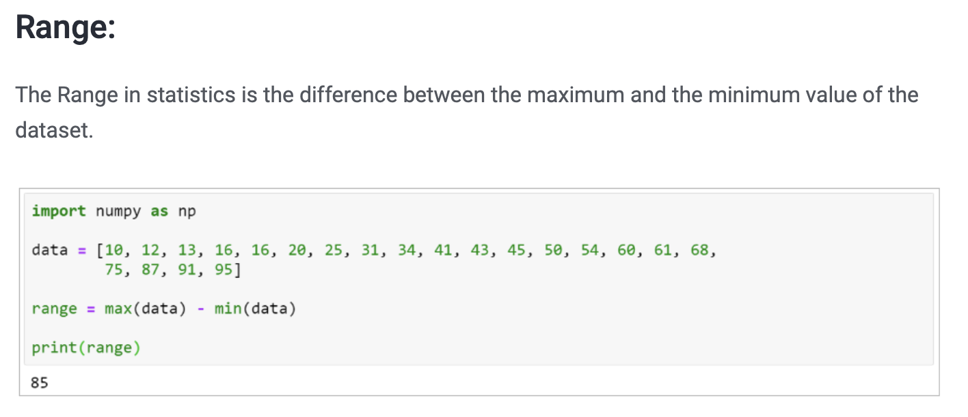
Range
The spread, or the distance, between the lowest and highest values of a variable.
To get the range for a variable, you subtract its lowest value from its highest value.

Slide 41
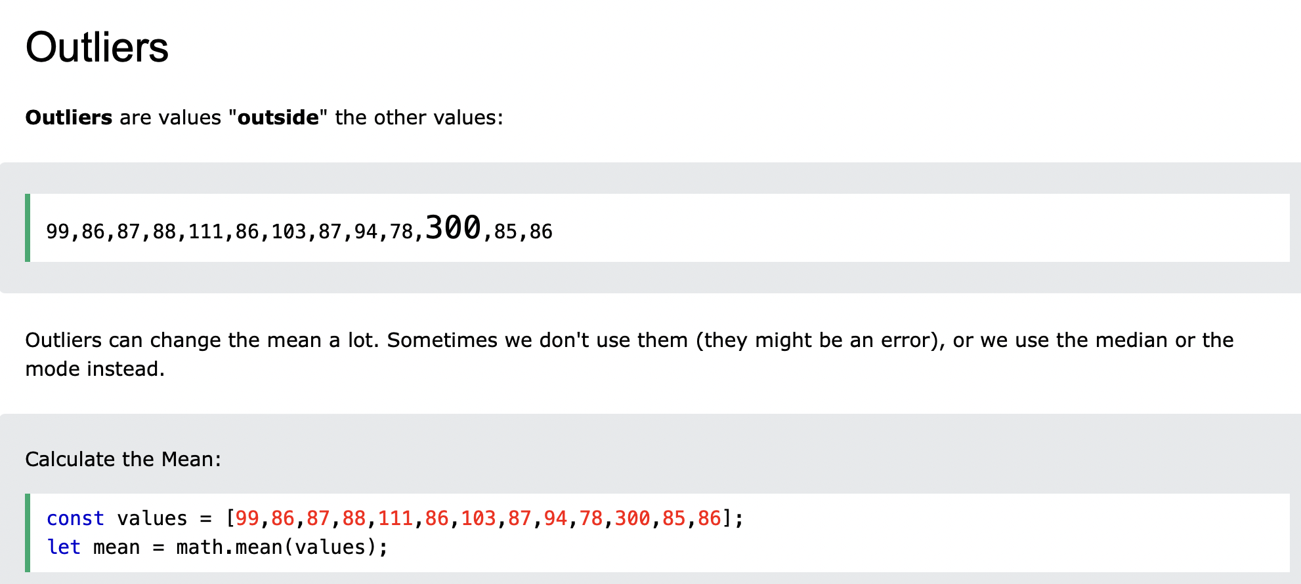
Outliers

Slide 42
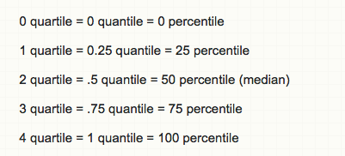
Interquartile Range
A quartile is the value that marks one of the divisions that breaks a series of values into four equal parts.
The median is a quartile and divides the cases in half.
25th percentile is a quartile that divides the first ¼ of cases from the latter ¾.
75th percentile is a quartile that divides the first ¾ of cases from the latter ¼.
The interquartile range is the distance or range between the 25th percentile and the 75th percentile. Below, what is the interquartile range?
25% of cases
25%
25%
25% of cases
0 250 500 750 1000

Slide 43
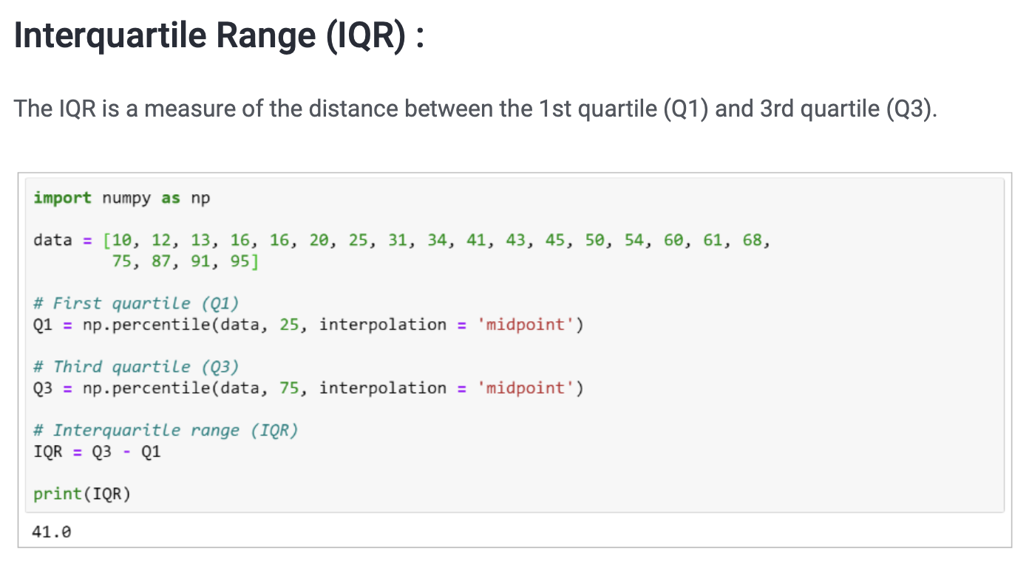
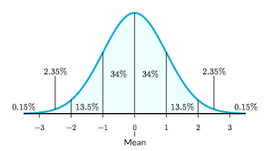
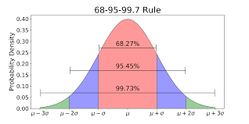
The rule of 68-95-99.7

Slide 44
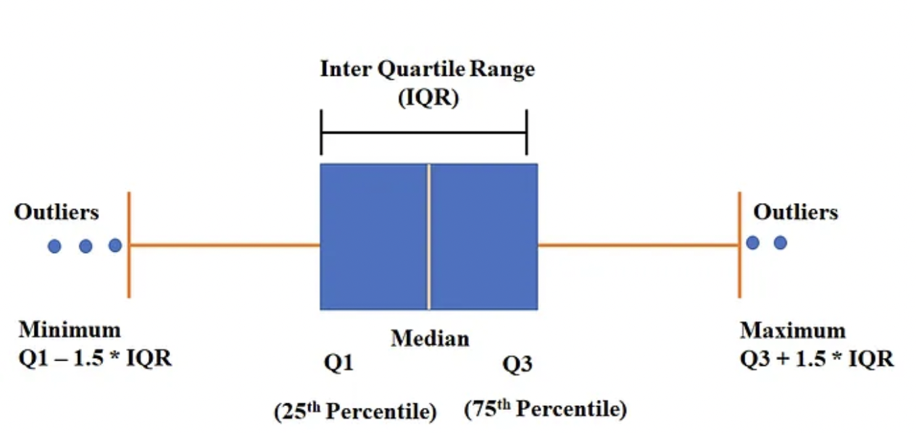
Box plots
A box plot also known as Five Number Summary, summarizes data using the median, upper quartile, lower quartile, and the minimum and maximum values. It allows you to see important characteristics of the data at a glance(visually). This also help us to visualize outliers in the data set. Box plot or Five Number Summary has below five information.
1.Median
2. Lower Quartile(25th Percentile)
3. Upper Quartile(75th Percentile)
4. Minimum Value
5.Maximum Value

Slide 45
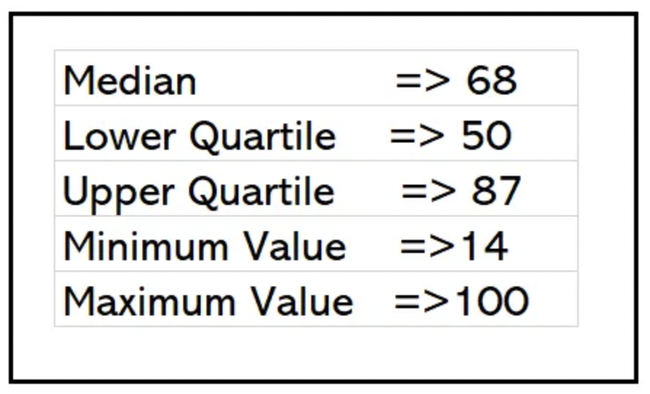
Example
take the set of numbers given
14, 19, 100, 27, 54, 52, 93, 50, 61, 87,68, 85, 75, 82, 95
Arrange the data in increasing (ascending) order
14, 19, 27, 50, 52, 54, 61, 68, 75, 82, 85, 87, 93, 95, 100

Slide 46
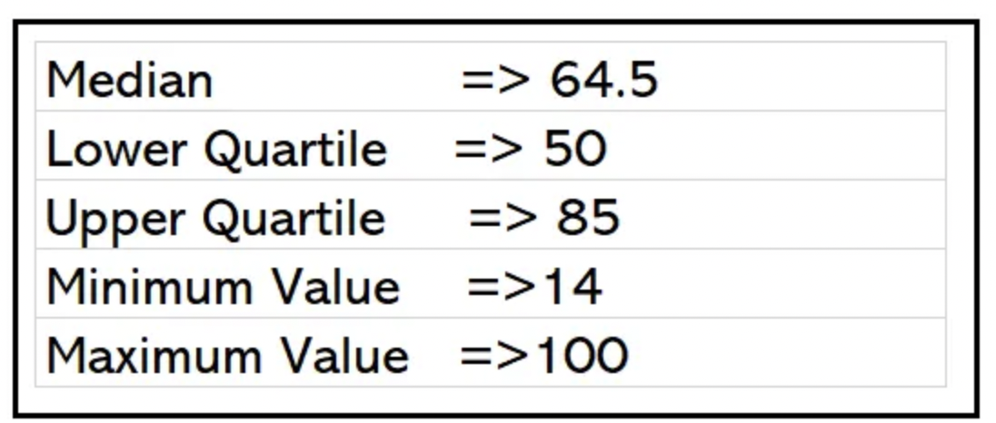
IQR
Interquartile Range(IQR) is difference between Upper quartile and Lower quartile.
As per picture,our Lower quartile is 50 and Upper quartile is 87
Another example We have 14 records below.
14, 19, 100, 27, 54, 52, 93, 50, 61, 87,68, 85, 75, 82
Arrange the data in increasing(ascending) order
14, 19, 27, 50, 52, 54, 61, 68, 75, 82, 85, 87, 93, 100

Slide 47
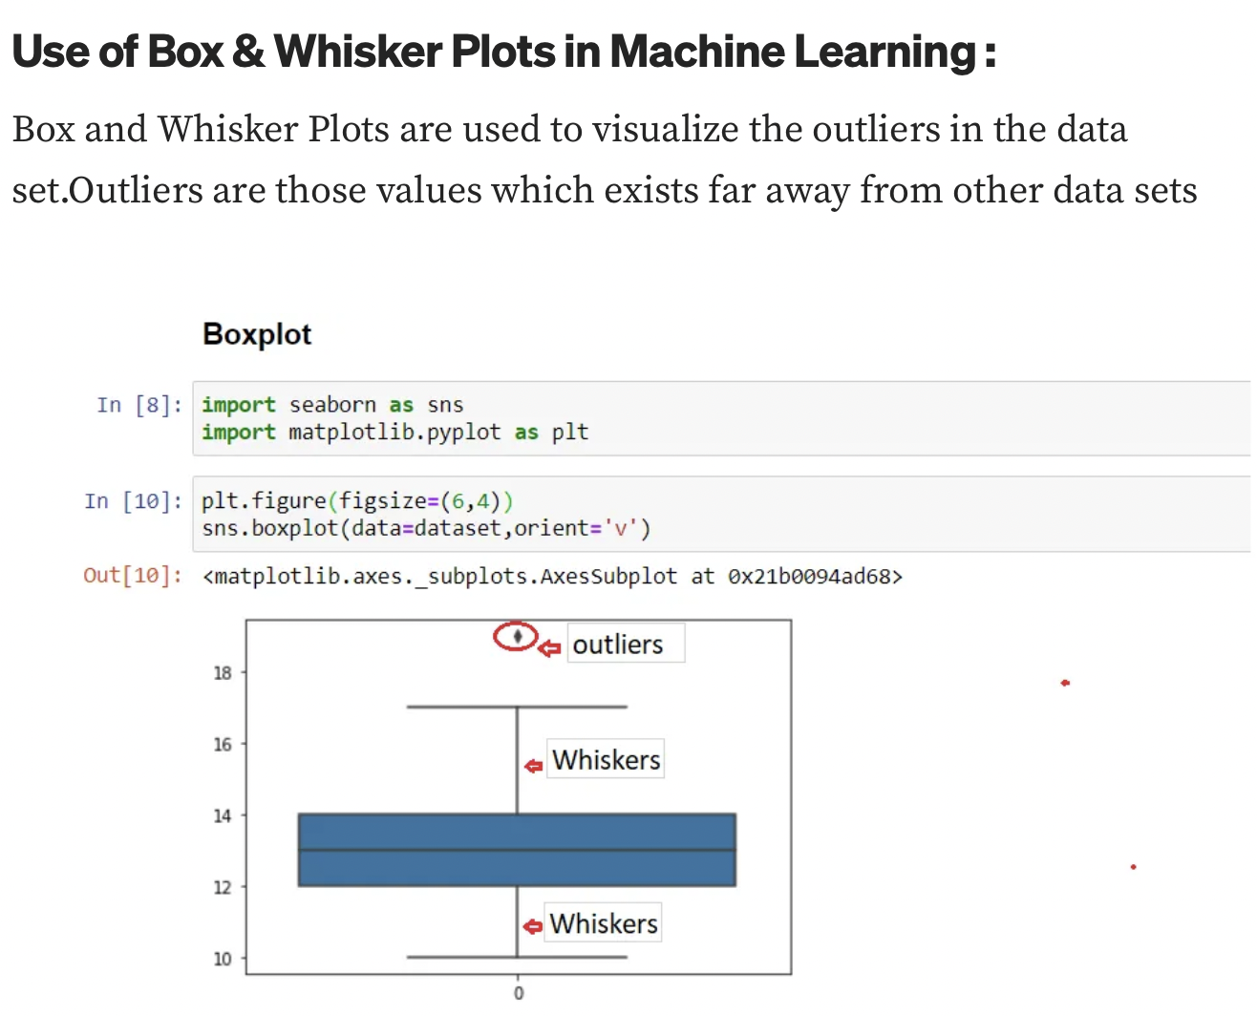
Box plots

Slide 48
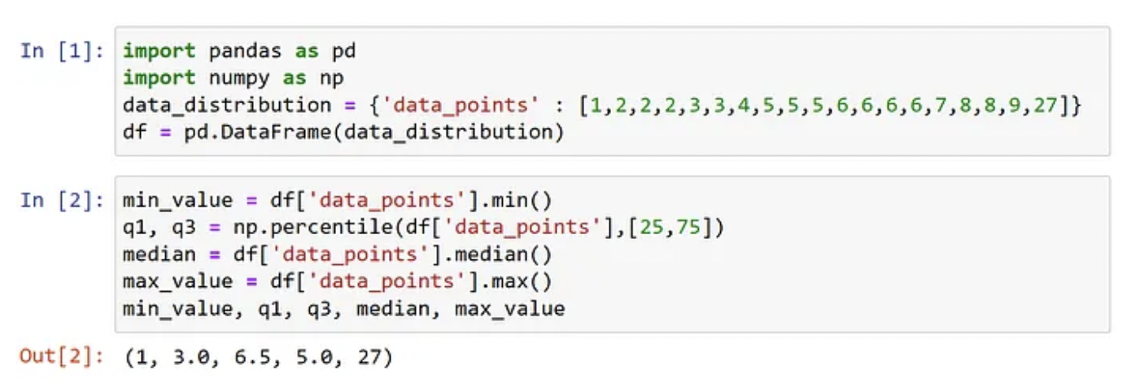
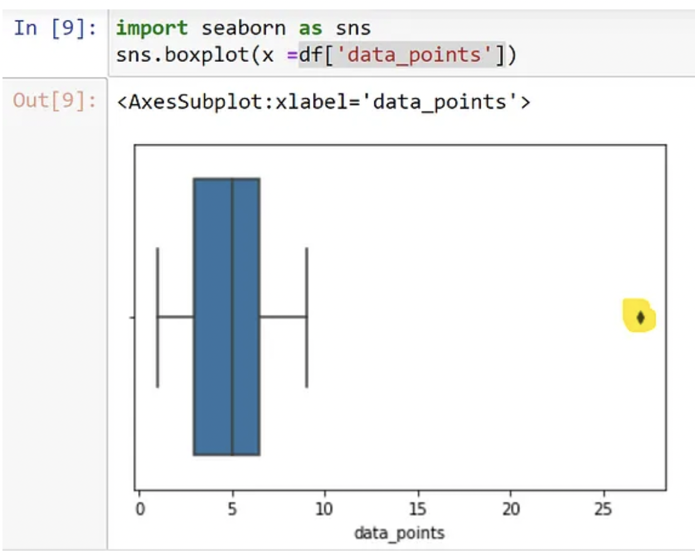
Box plots

Slide 49
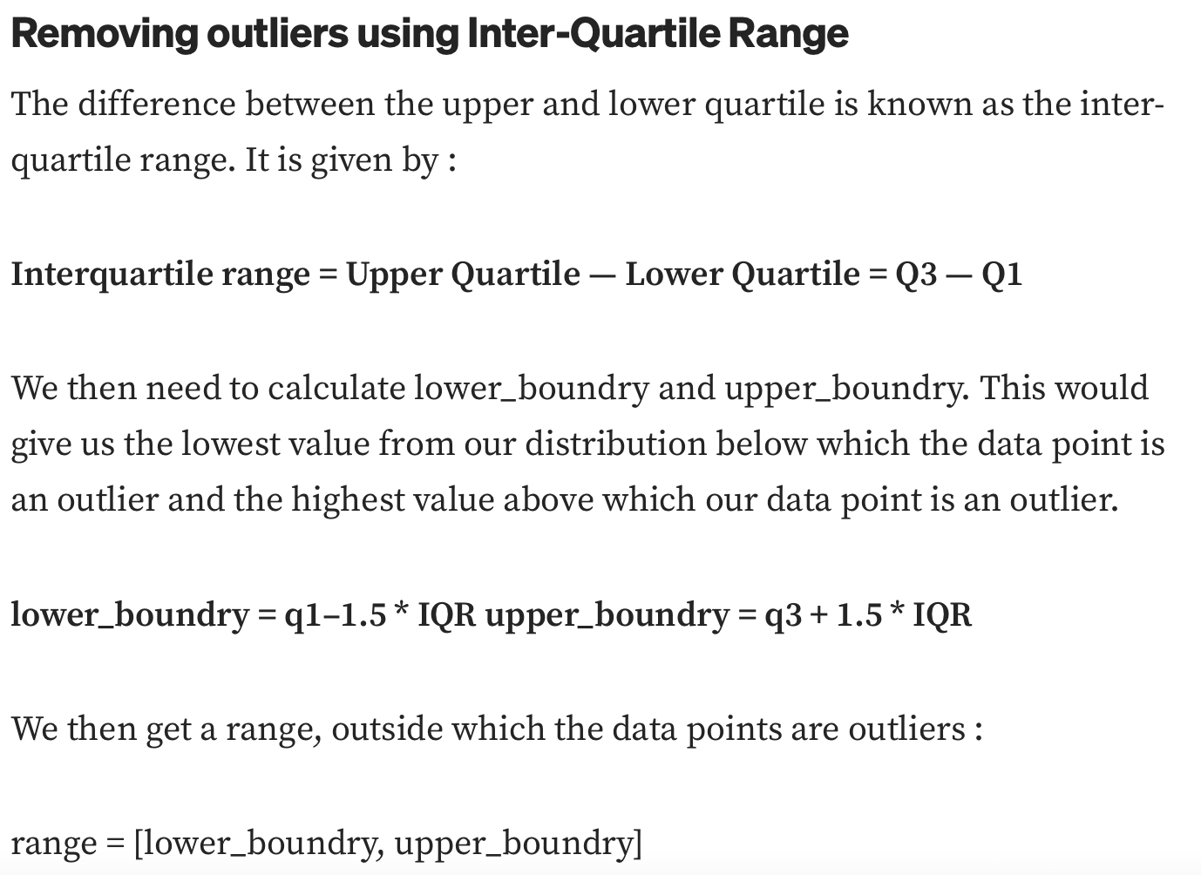
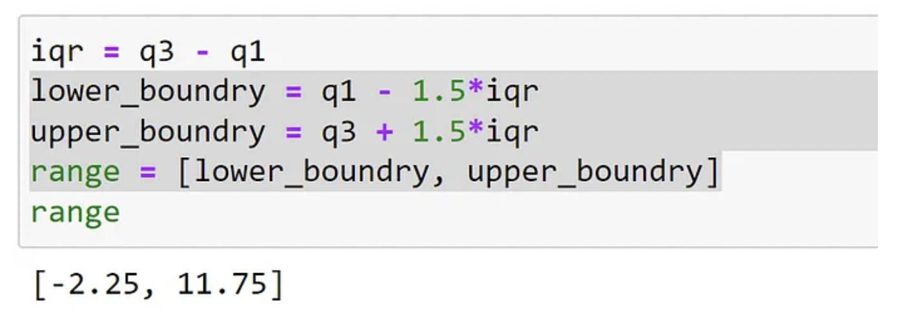
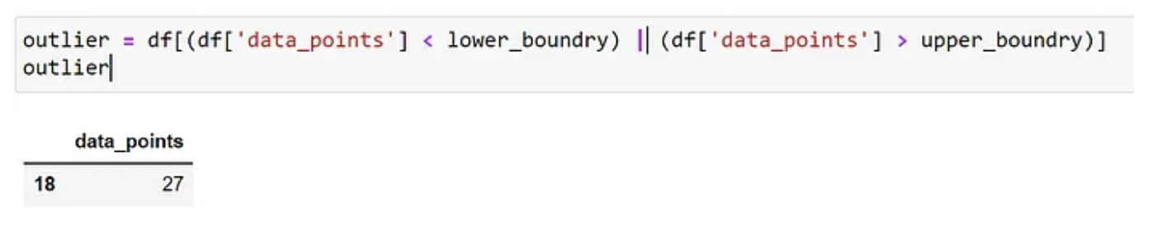
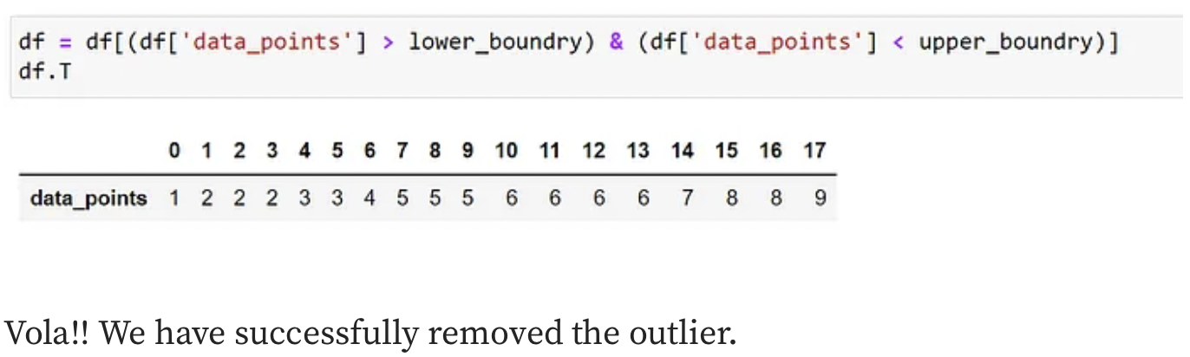
Removing outliers

Slide 50
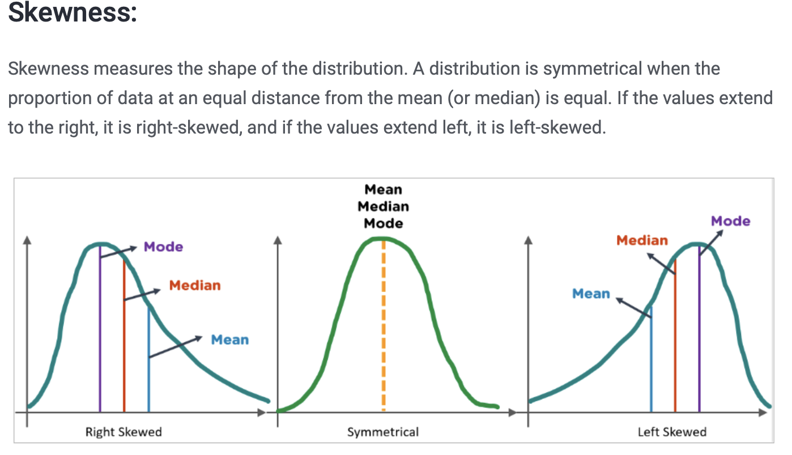
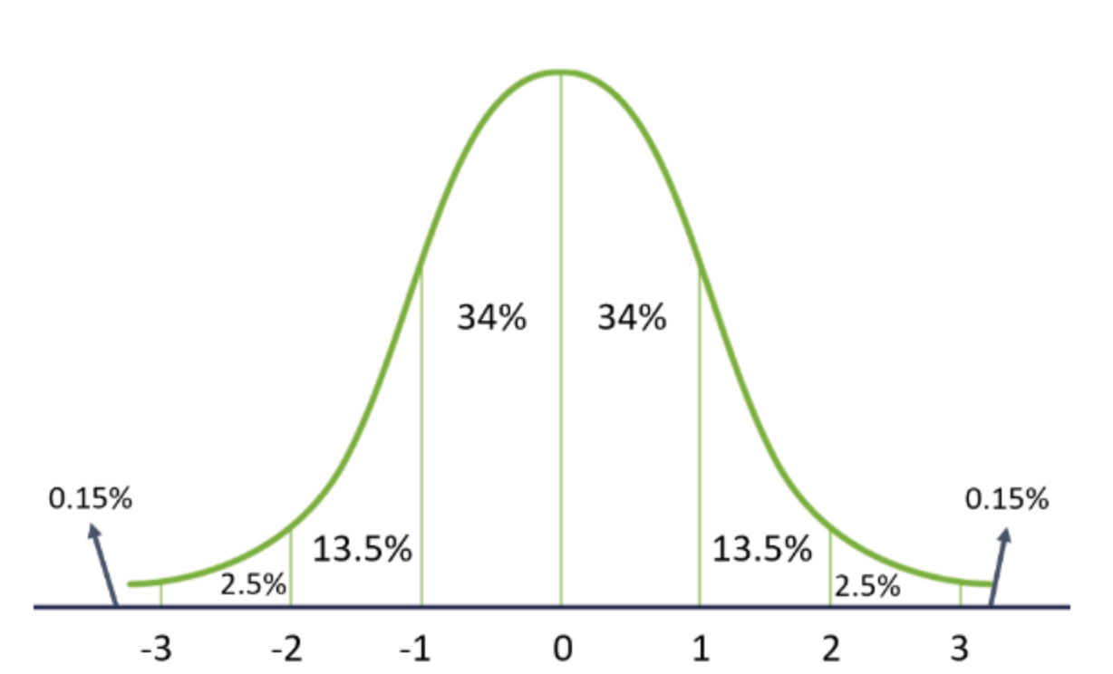
Distribution
Gaussian (normal) distribution is a popular continuous probability distribution for any random variable. It is characterized by 2 parameters (mean μ and standard deviation σ). Many natural phenomena follow a normal distribution, such as the heights of people and IQ scores.

Slide 51
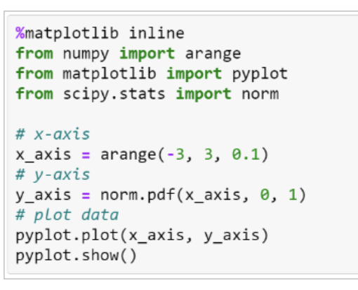
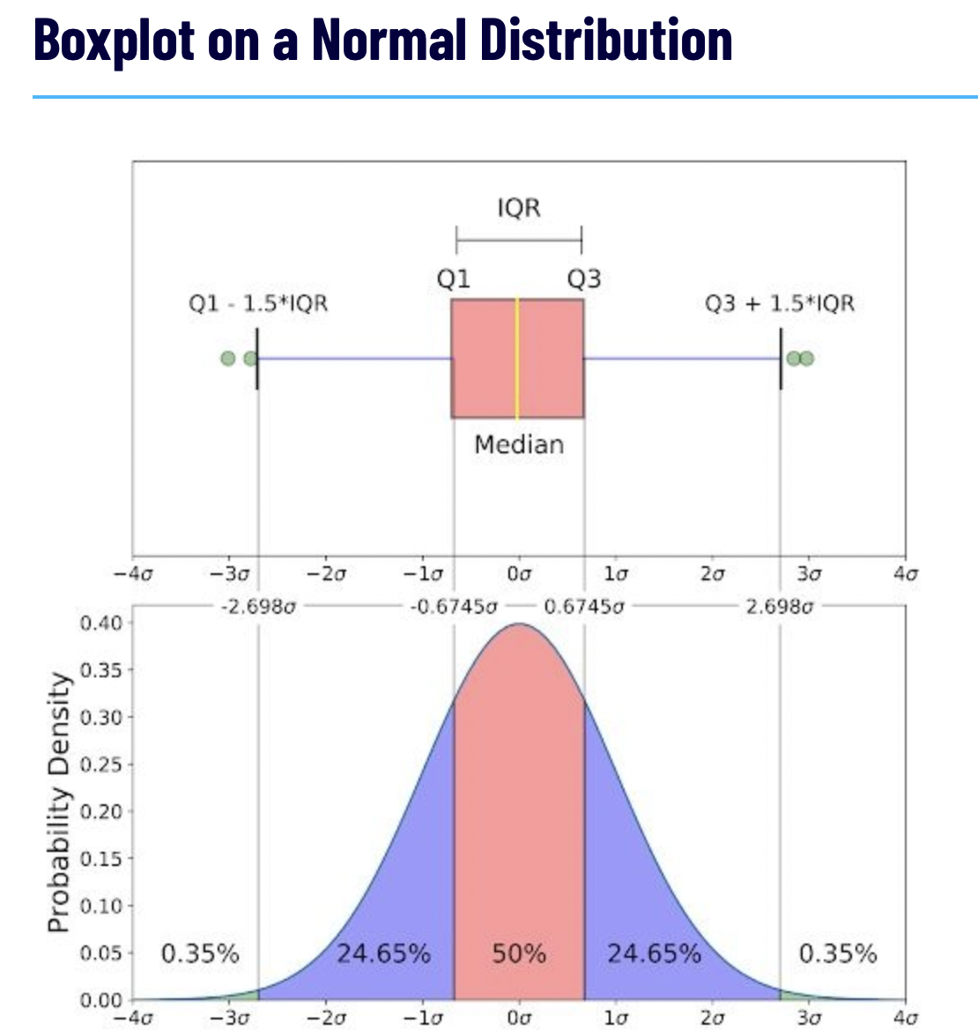
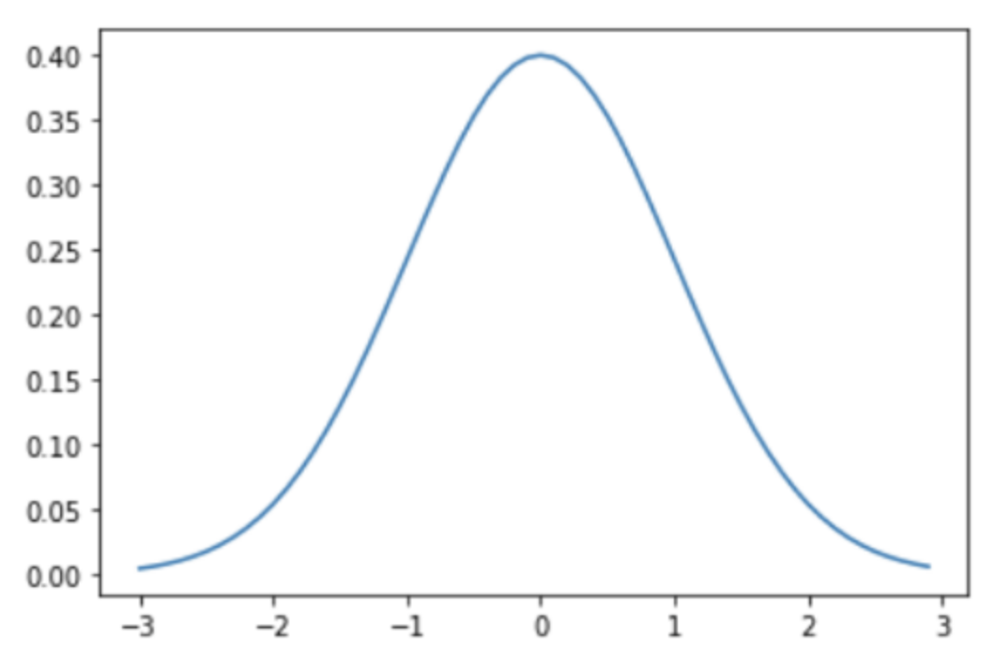
Gaussian Distribution
Properties of Gaussian Distribution:
The mean, median, and mode are the same
It has a symmetrical bell shape
68% data lies within 1 standard deviation of the mean
95% data lie within 2 standard deviations of the mean
99.7% of the data lie within 3 standard deviations of the mean

Slide 52
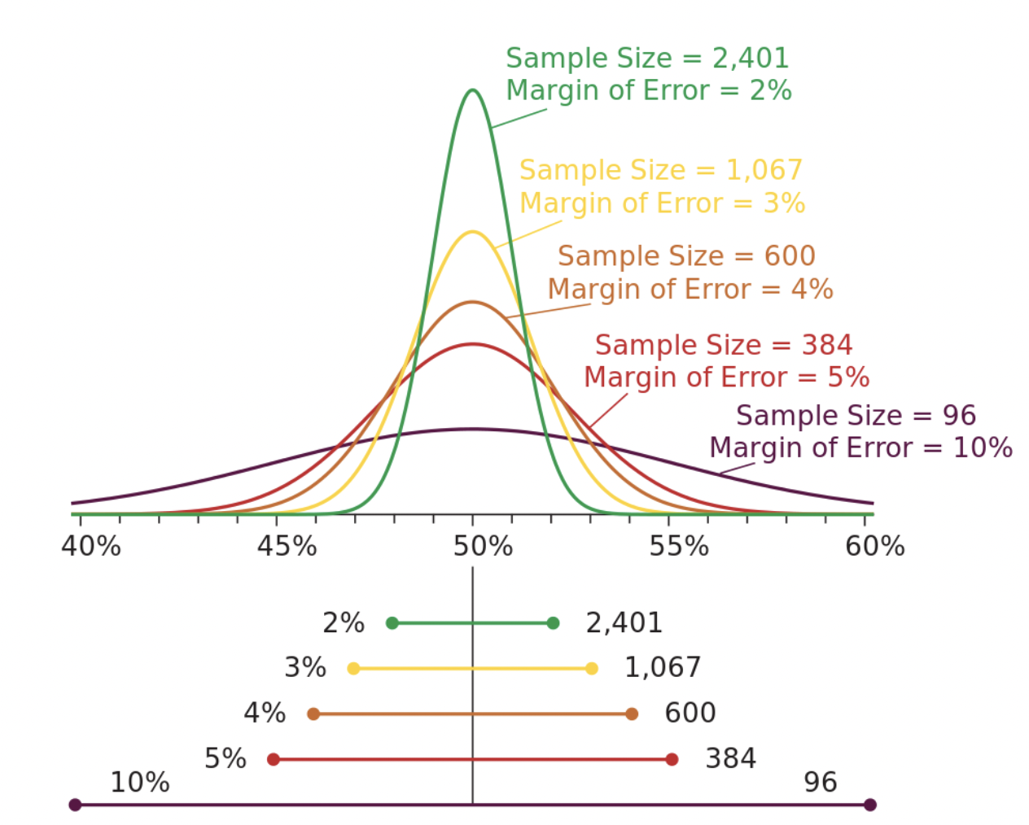
The Margin of Error
Statisticians will always try to predict everything with 100% accuracy.
But, there will always be some uncertainty.
The Margin of Error is the number that quantifies this statistical uncertainty.
Different margins define different ranges for where we believe the correct answers can be found.
The acceptable margin is a matter of judgment, and relative to how important the answer is.
The more samples we collect, the lower the margin of error is:
How to Interpret Margin of Error
Suppose 55% of a sampled population say they plan to vote "Yes".
When projecting this to a whole population, you add/subtract the margin of error to give a range of possible results.
With a margin of error of 3%, you are confident that between 52% and 58% will vote "Yes".
With a margin of error of 10%, you are confident that between 45% and 65% will vote "Yes".

Slide 53
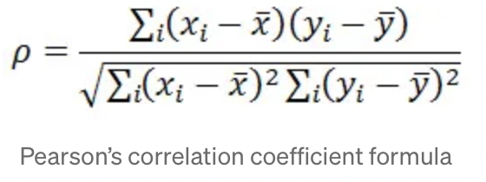
Correlation
A correlation coefficient is a statistical measure of the degree to which changes to the value of one variable predict changes to the value of another.
When to use it?
When you want to know about the association or relationship between two continuous variables
Ex) Taller people tend to be heavier.
If an increase in one variable tends to be associated with a decrease in the other then this is known as a negative correlation. An example would be height above sea level and temperature
What does it tell you?
If a linear relationship exists between two variables, and how strong that relationship is
What do the results look like?
The correlation coefficient = Pearson’s r
Ranges from -1 to +1
Pearson’s correlation coefficient is a measure of the strength of a linear association between two variables and is denoted by r. Basically, a Pearson’s correlation attempts to draw a line of best fit through two variables' data.

Slide 54
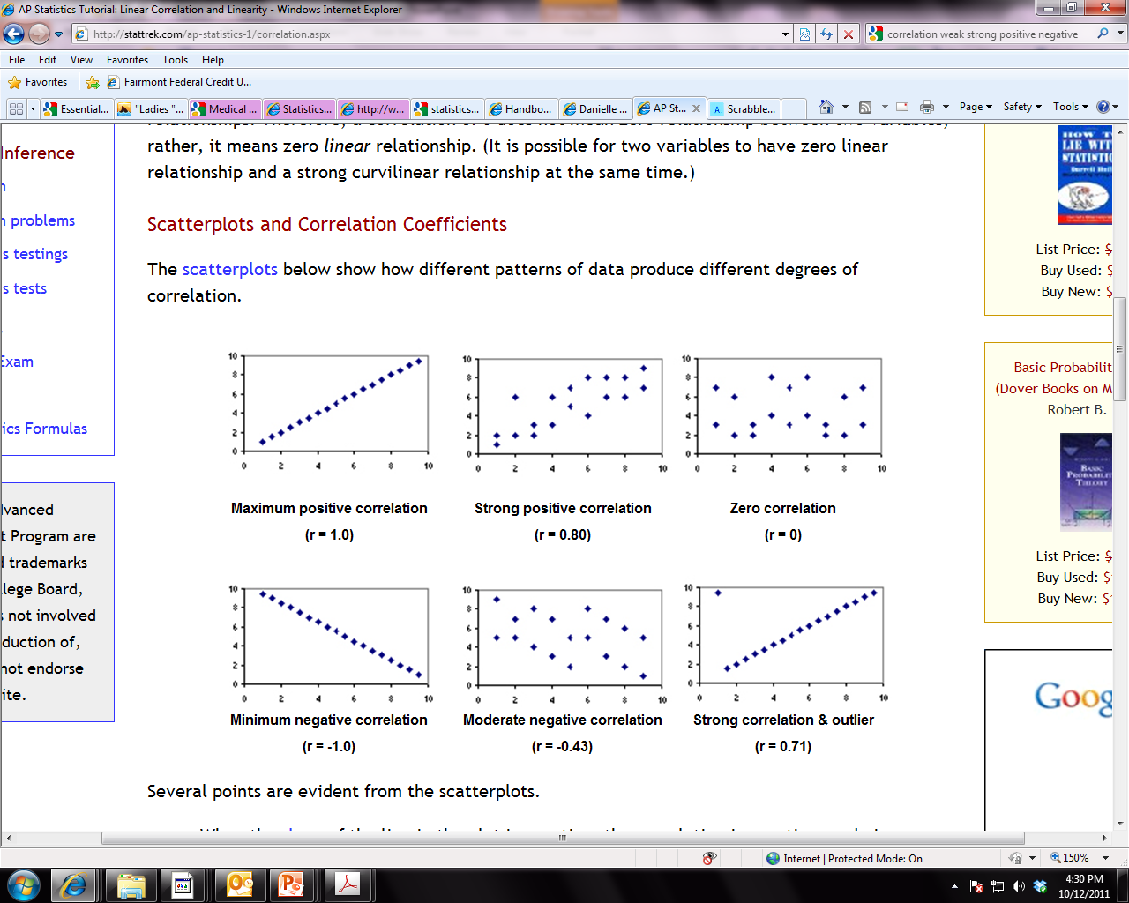
Correlation
Guide for interpreting strength of correlations:
0 – 0.25 = Little or no relationship
0.25 – 0.50 = Fair degree of relationship
0.50 - 0.75 = Moderate degree of relationship
0.75 – 1.0 = Strong relationship
1.0 = perfect correlation

Slide 55
Correlation
How do you interpret it?
If r is positive, high values of one variable are associated with high values of the other variable (both go in SAME direction - ↑↑ OR ↓↓)
Ex) Diastolic blood pressure tends to rise with age, thus the two variables are positively correlated
If r is negative, low values of one variable are associated with high values of the other variable (opposite direction - ↑↓ OR ↓ ↑)
Ex) Heart rate tends to be lower in persons who exercise frequently, the two variables correlate negatively
A correlation of 0 indicates NO linear relationship.
How do you report it?
“Diastolic blood pressure was positively correlated with age (r = .75, p < . 05).”
Tip: Correlation does NOT equal causation!!! Just because two variables are highly correlated, this does NOT mean that one CAUSES the other!!!

Slide 56
Examples
Positive
The more time you spend running on a treadmill, the more calories you will burn.
As the temperature goes up, ice cream sales also go up.
As a student's study time increases, so does his test average.
Negative
A student who has many absences has a decrease in grades.
As one exercises more, his body weight becomes less.

Slide 57
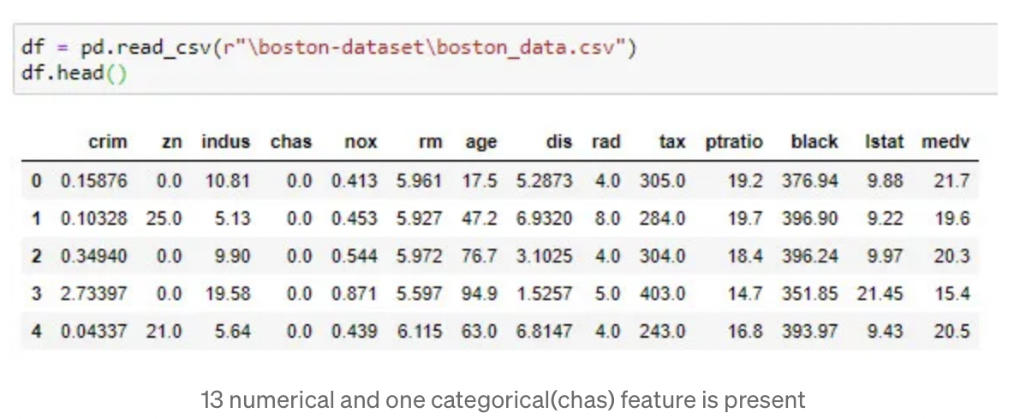
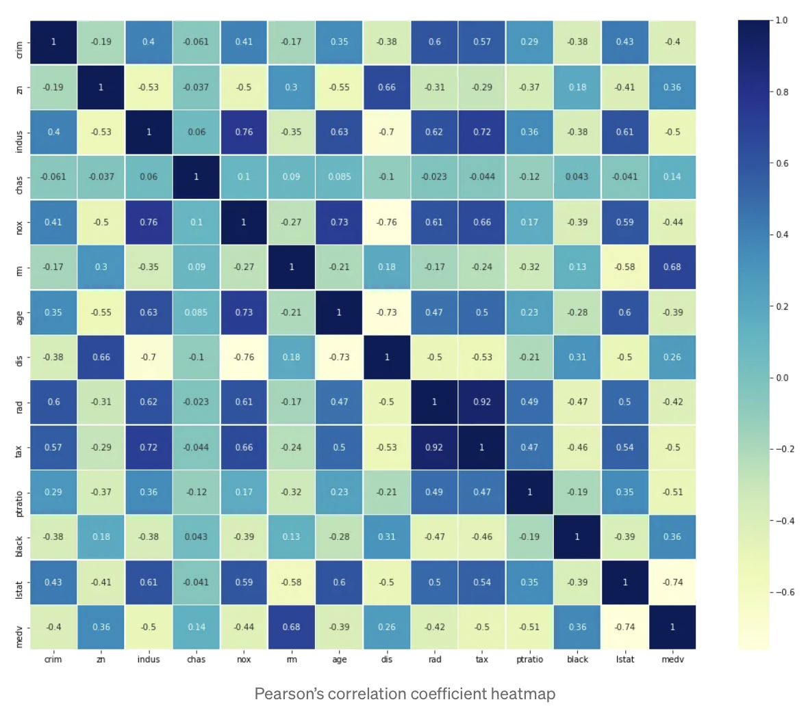
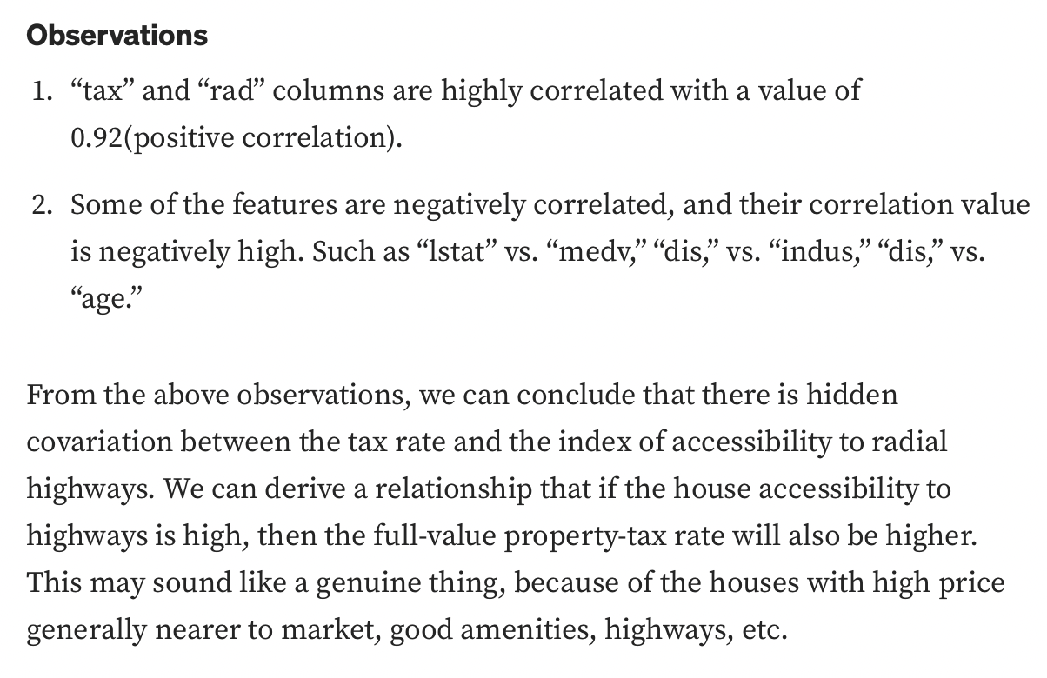
Examples

Slide 58
Visualization

Slide 59
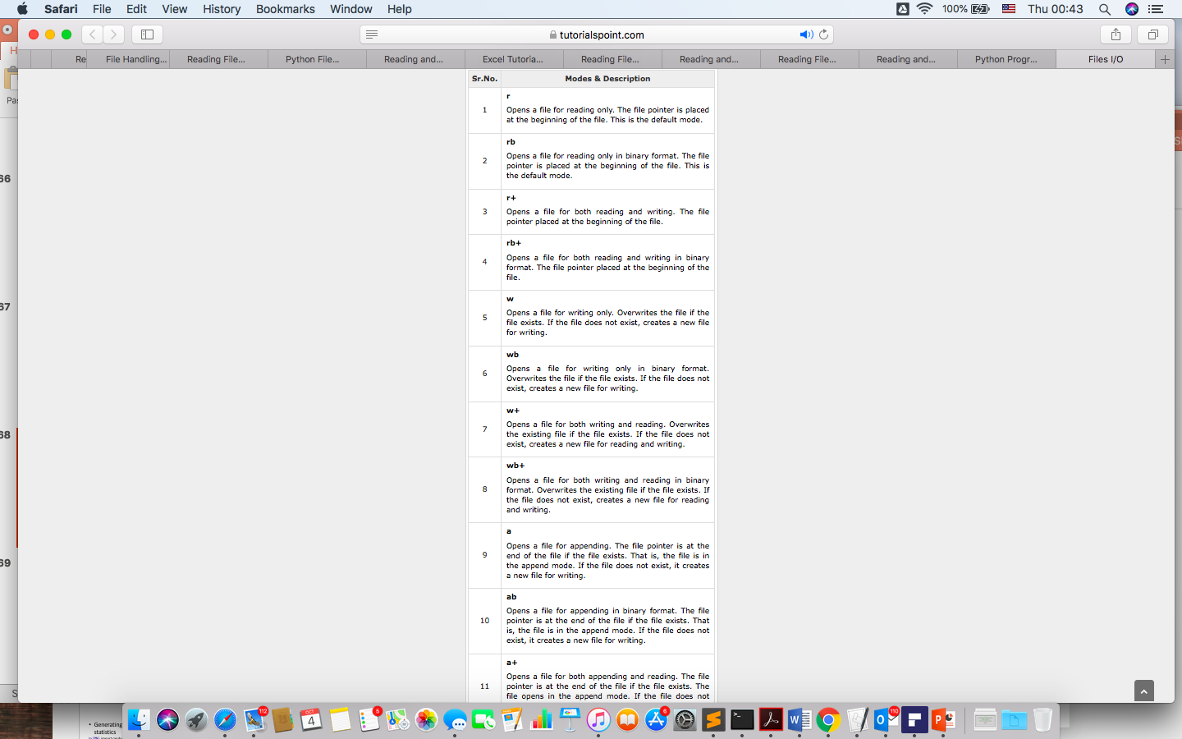
Input output files
file object = open(file_name [, access_mode])
access_mode − The access_mode determines the mode in which the file has to be opened, i.e., read, write, append, etc. A complete list of possible values is given below in the table. This is optional parameter and the default file access mode is read (r).

Slide 60
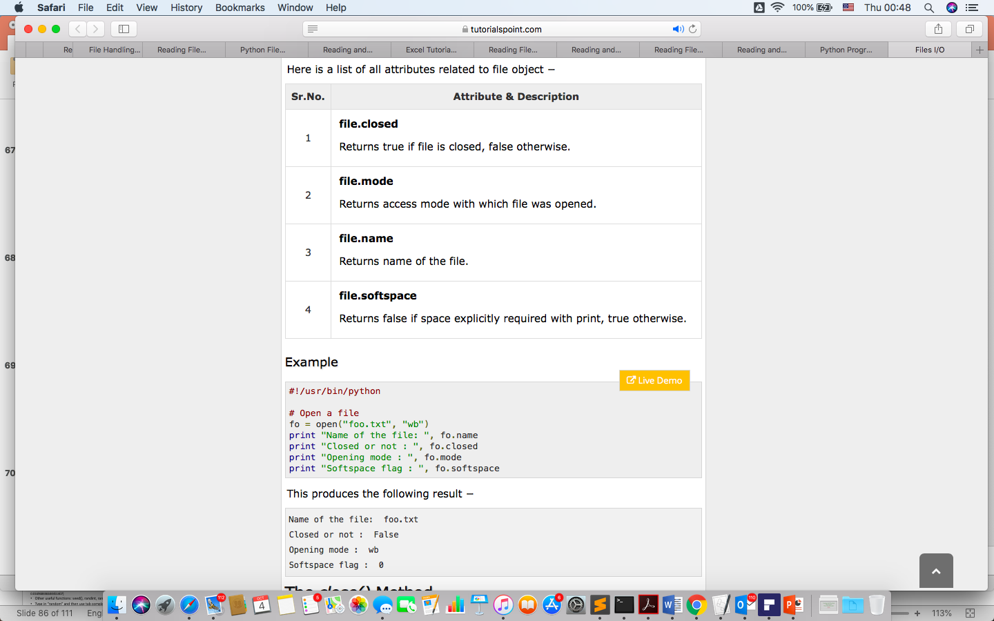

Slide 61
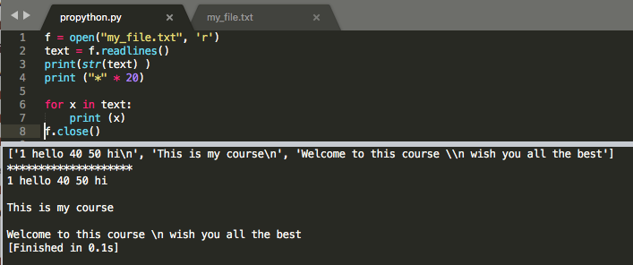
read(): It reads the entire file and returns it contents in the form of a string
readline(): It reads the first line of the file i.e till a newline character or an EOF in case of a file having a single line and returns a string
readlines(): It reads the entire file line by line and returns a list of line strings
f = open("my_file2.txt", 'w')
f.write("Hello Everyone!")
1 hello 40 50 hi
This is my course
Welcome to this course \n wish you all the best

Slide 62
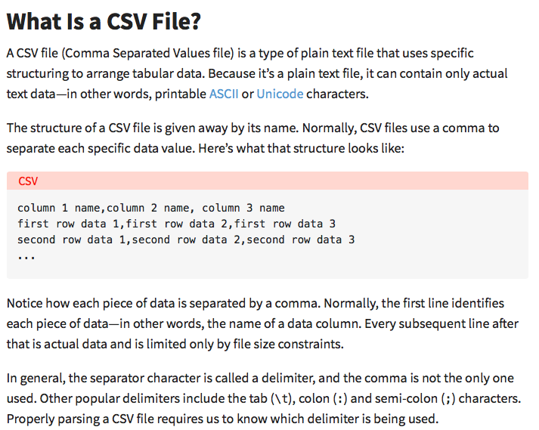
Notice how each piece of data is separated by a comma.

Slide 63
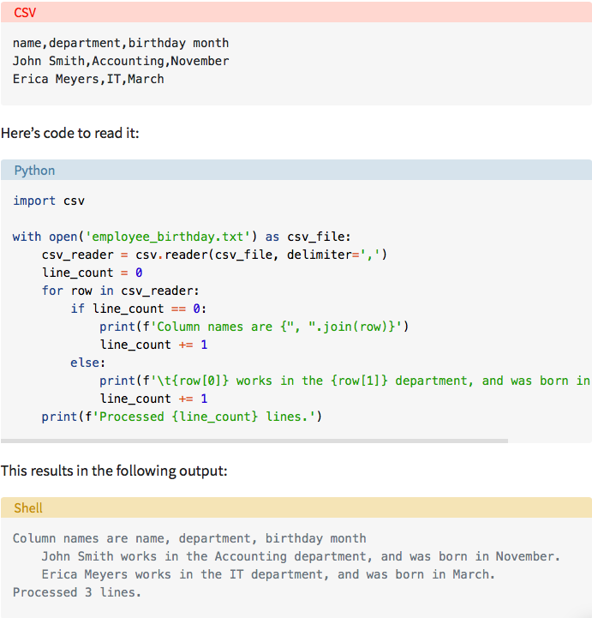

Slide 64
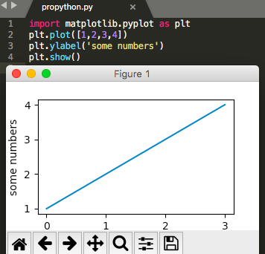
import matplotlib.pyplot as plt
matplotlib.pyplot is a collection of command style functions that make matplotlib work like MATLAB. Each pyplot unction makes some change to a figure: eg, create a figure, create a plotting area in a figure, plot some lines in a plotting area, decorate the plot with labels, etc....
https://www.youtube.com/watch?v=D4VlmL3G4_o
https://matplotlib.org/users/pyplot_tutorial.html

Slide 65
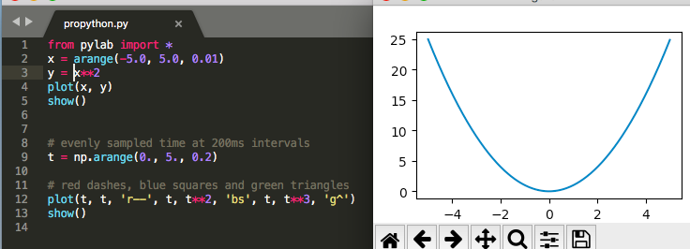
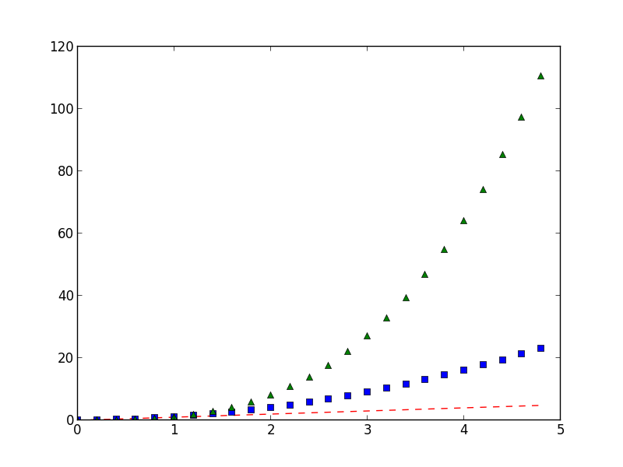
The required libraries are NumPy, SciPy and MatPlotLib. Installing PyLab is an easy way of setting up all the three libraries correctly.

Slide 66
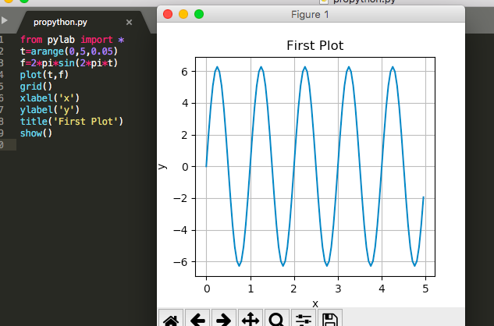
Another Example

Slide 67
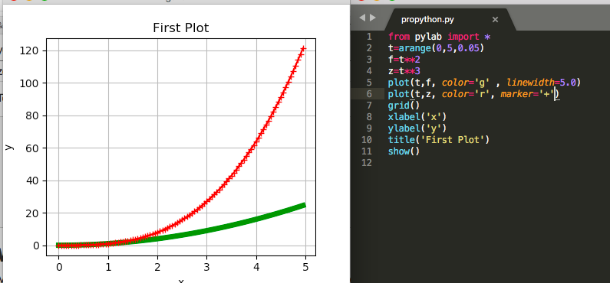
Plotting

Slide 68
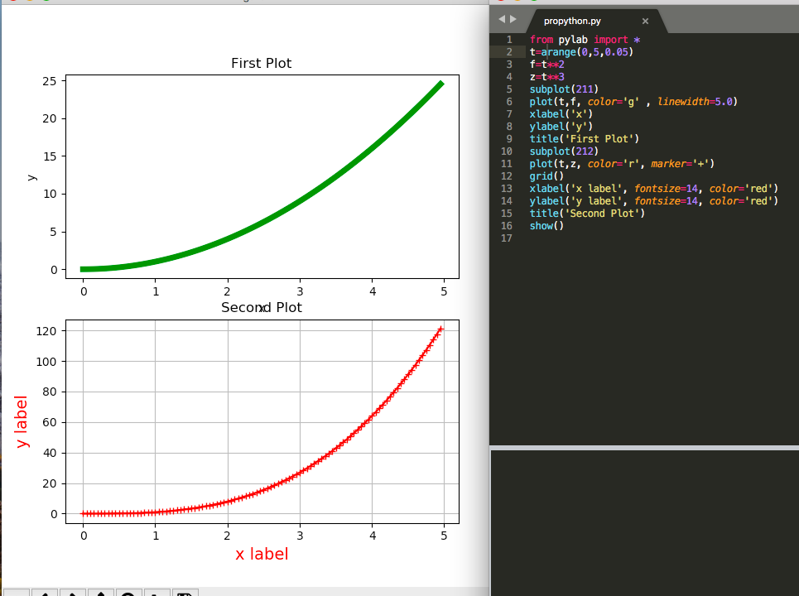
Working with multiple figures

Slide 69

BarChart

Slide 70

Barchart horizontally

Slide 71


Slide 72

Save the figure
fig.savefig('plot.pdf')
display plot.png

Slide 73

Pie chart

Slide 74

coding!!
Try the code at home
import numpy as np
import matplotlib.pyplot as plt
N=50
X= np.random.rand(N)
y= np.random.rand(N)
colors= np.random.rand(N)
plt.scatter(X, y, c=colors)
plt.show()

Slide 75
Scikit-learn
Machine Learning library
Designed to inter-operate with NumPy (n-dimensional arrays) and SciPy (Science and Math)
Features:
Classification
Clustering
Regression
...
Website: http://scikit-learn.org/
Import
import sklearn
Fun fact: the name originates from the fact that this library is a scientific toolbox built around SciPy

